Slide 1
Protecting Yourself from Scams
How to Identify and Protect Yourself from Common Scams

Slide 2
Why Talk About Scams?
Scams are more sophisticated than ever
Anyone can be a target
The most effective defense is to learn from each other and share

Slide 3
Common Types of Scams
Text Message Scams (Smishing)
Email Scams (Phishing)
Phone Scams (Vishing)
Web-Based Scams
Others (Romance, Job, Investment, etc.)
AI Scams

Slide 4
Common Traits of Scams
Unsolicited contact
Urgency or threats
Don’t tell anyone else
Requests for personal info
Strange grammar or links

Slide 5
Text Message Scams (Smishing)
Claim to be from banks, delivery companies
Urgent tone ("verify your account!")
Links to fake websites
Wrong number scams trying to get personal information

Slide 6
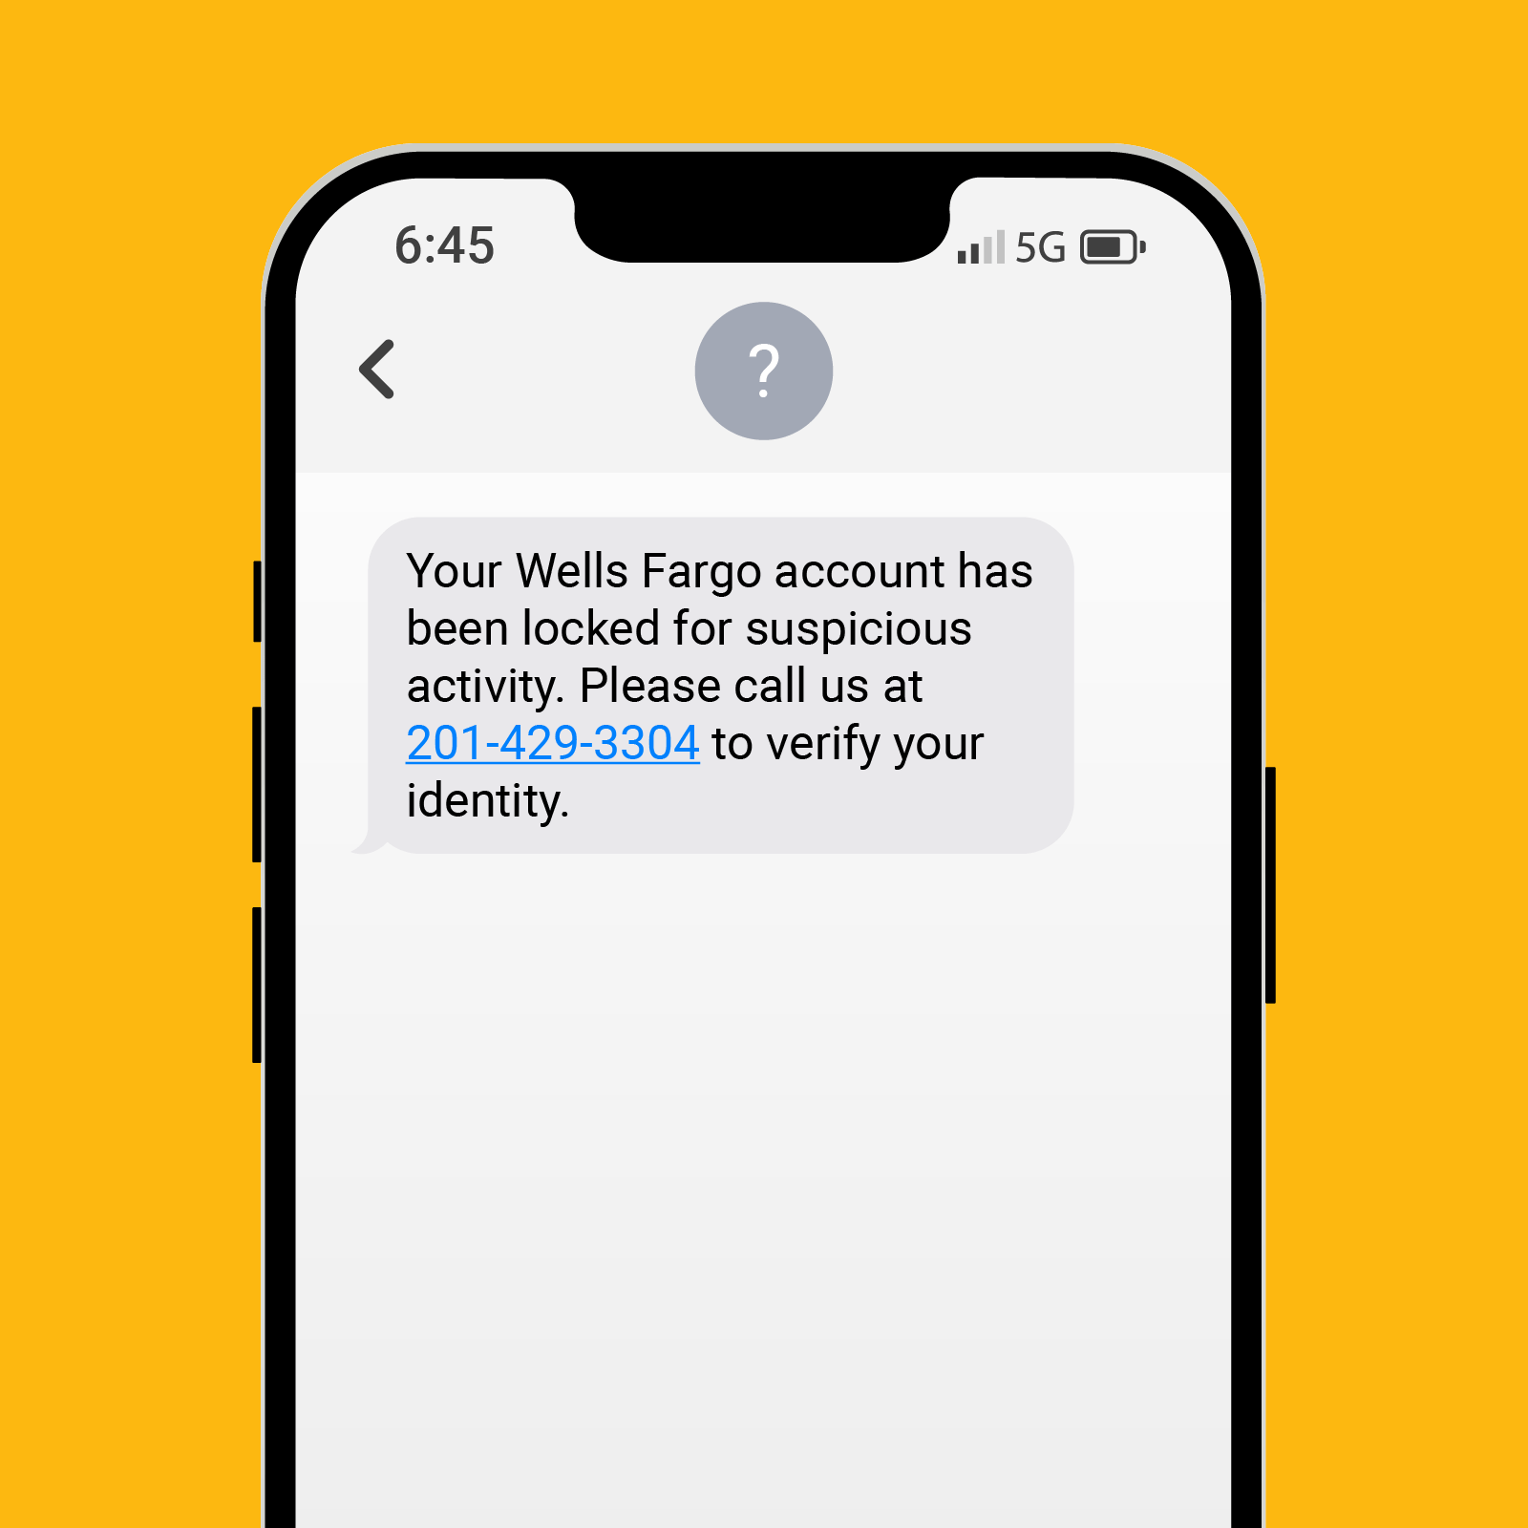

Slide 7
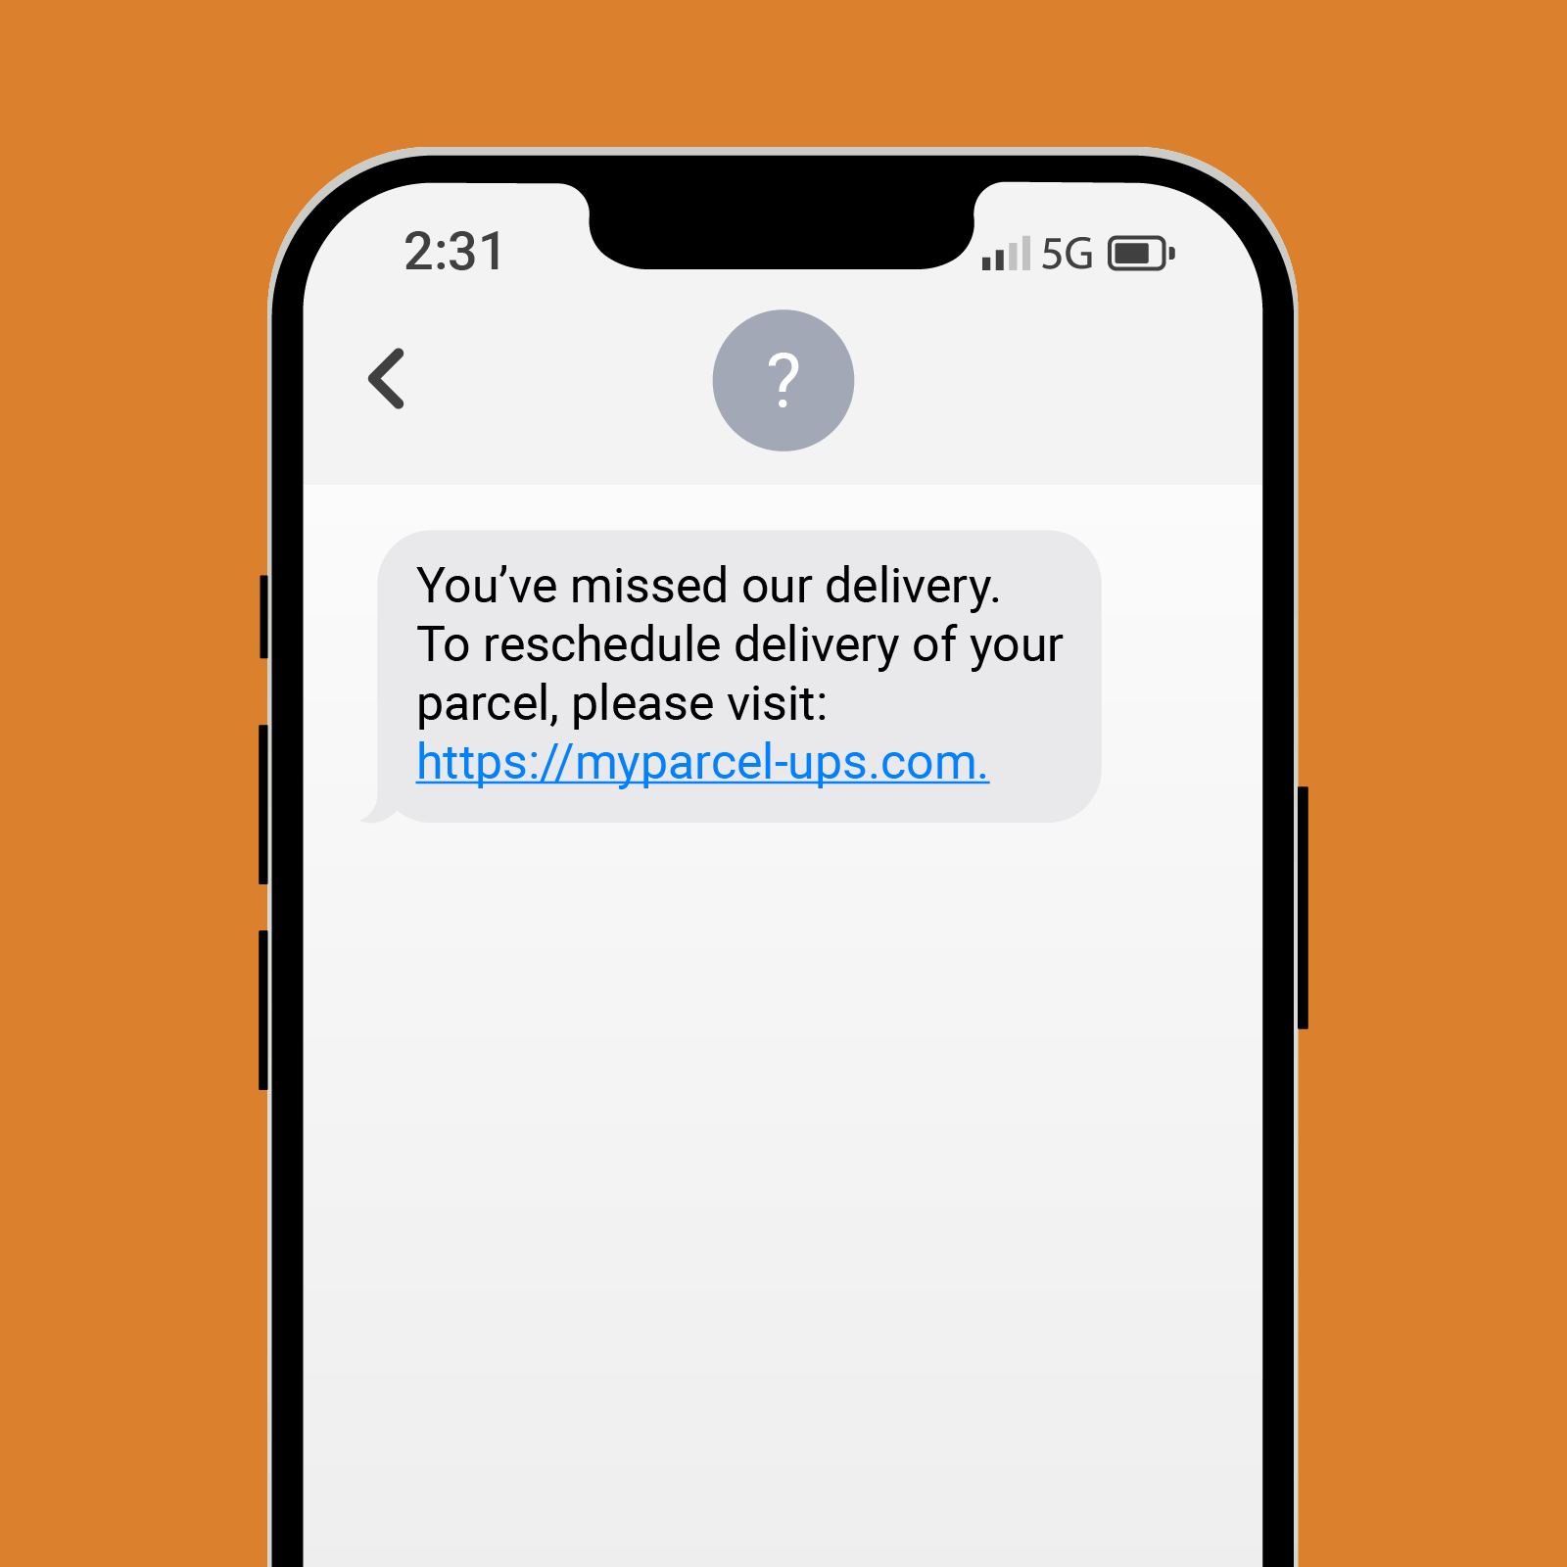

Slide 8


Slide 9
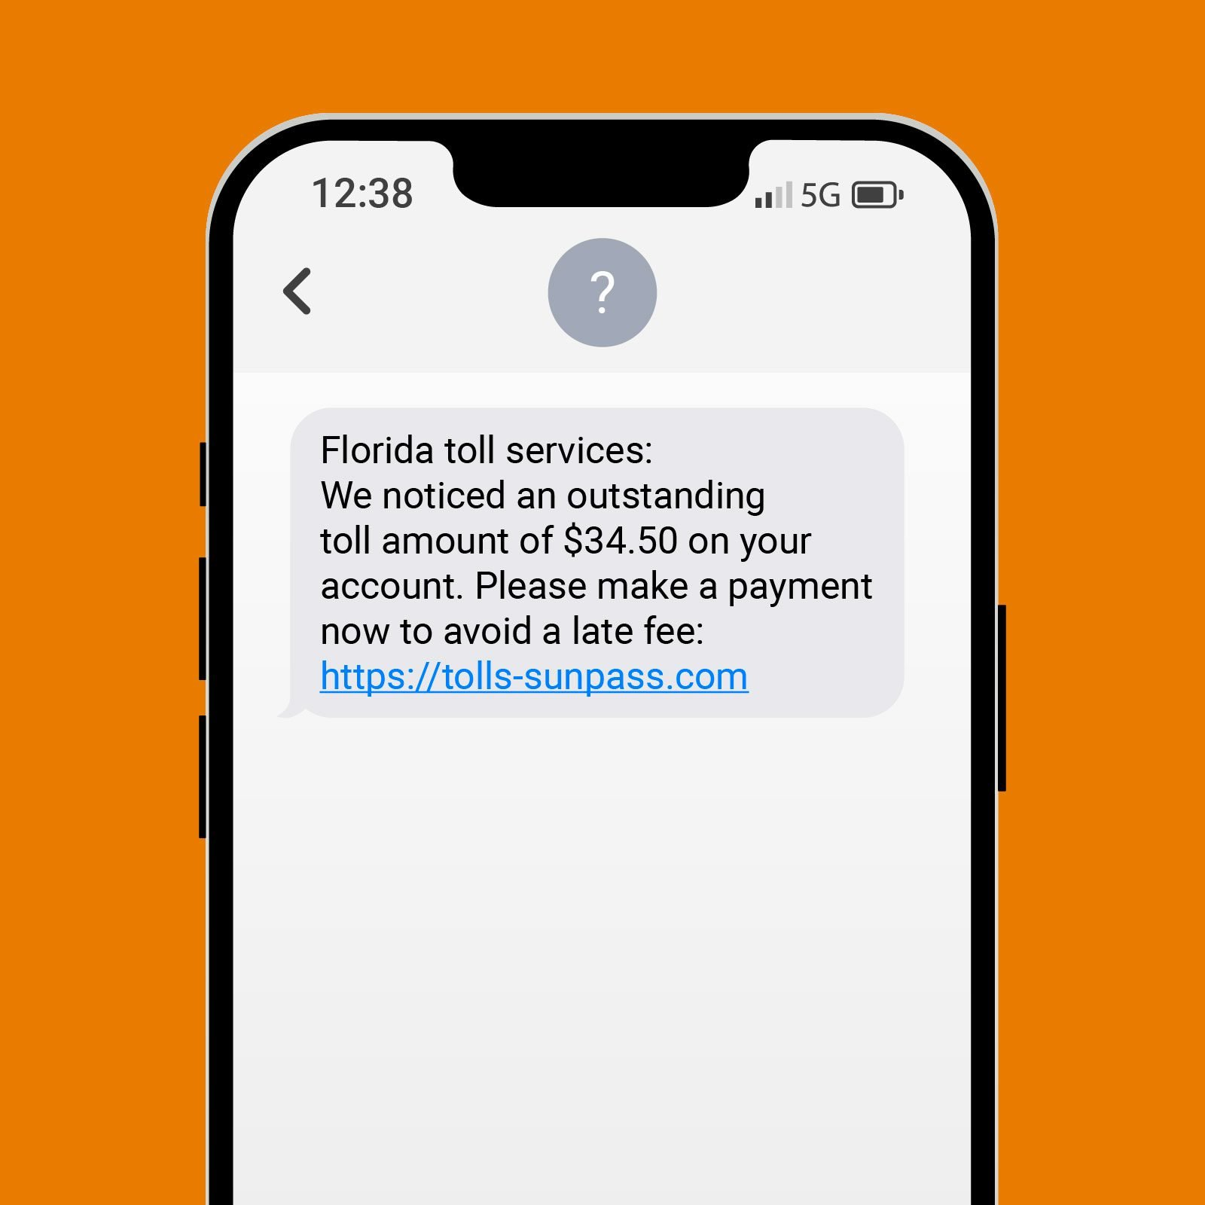

Slide 10
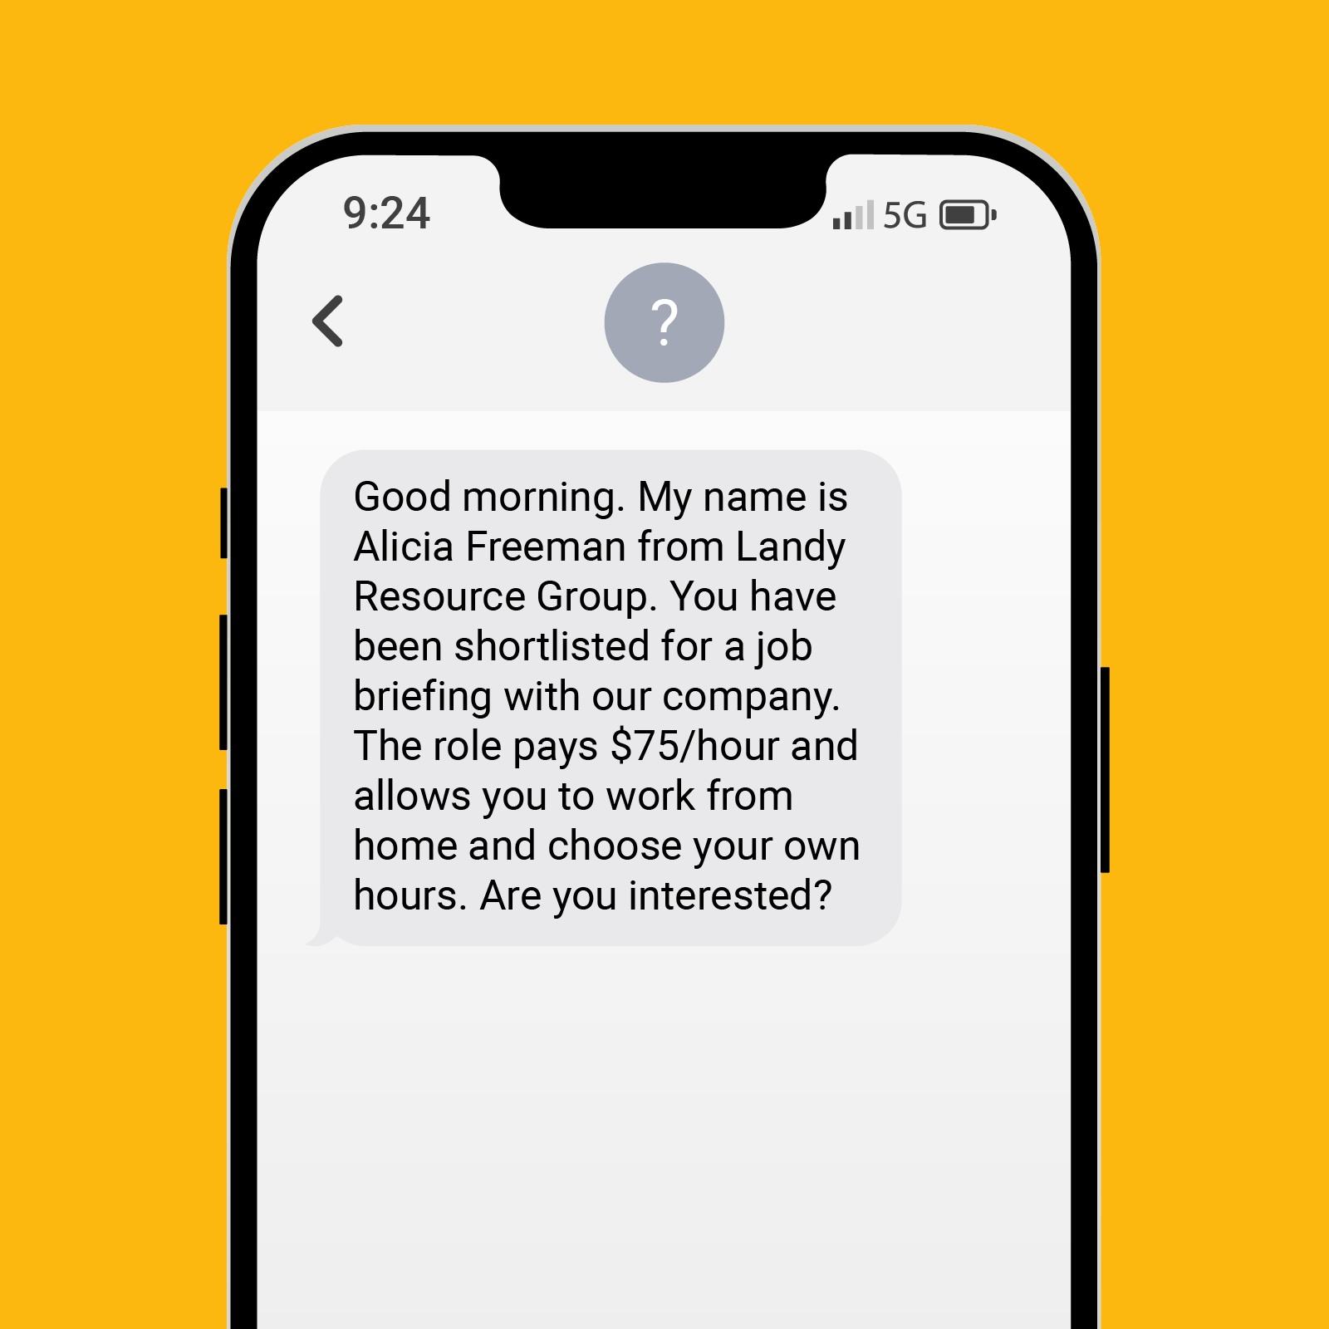

Slide 11
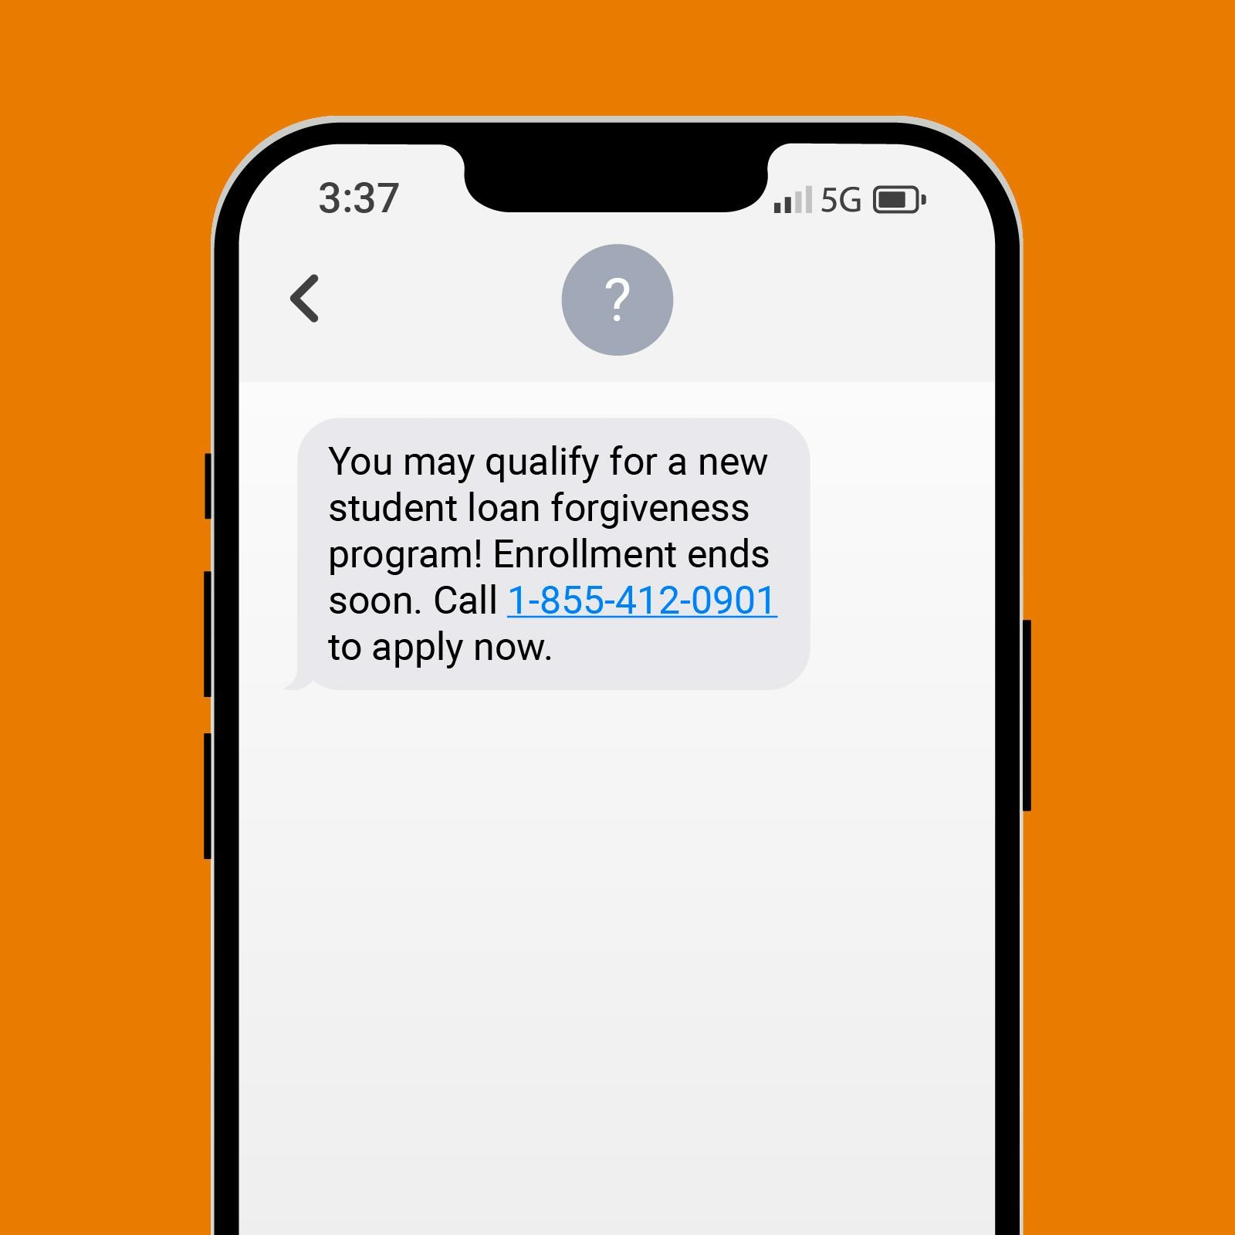

Slide 12


Slide 13
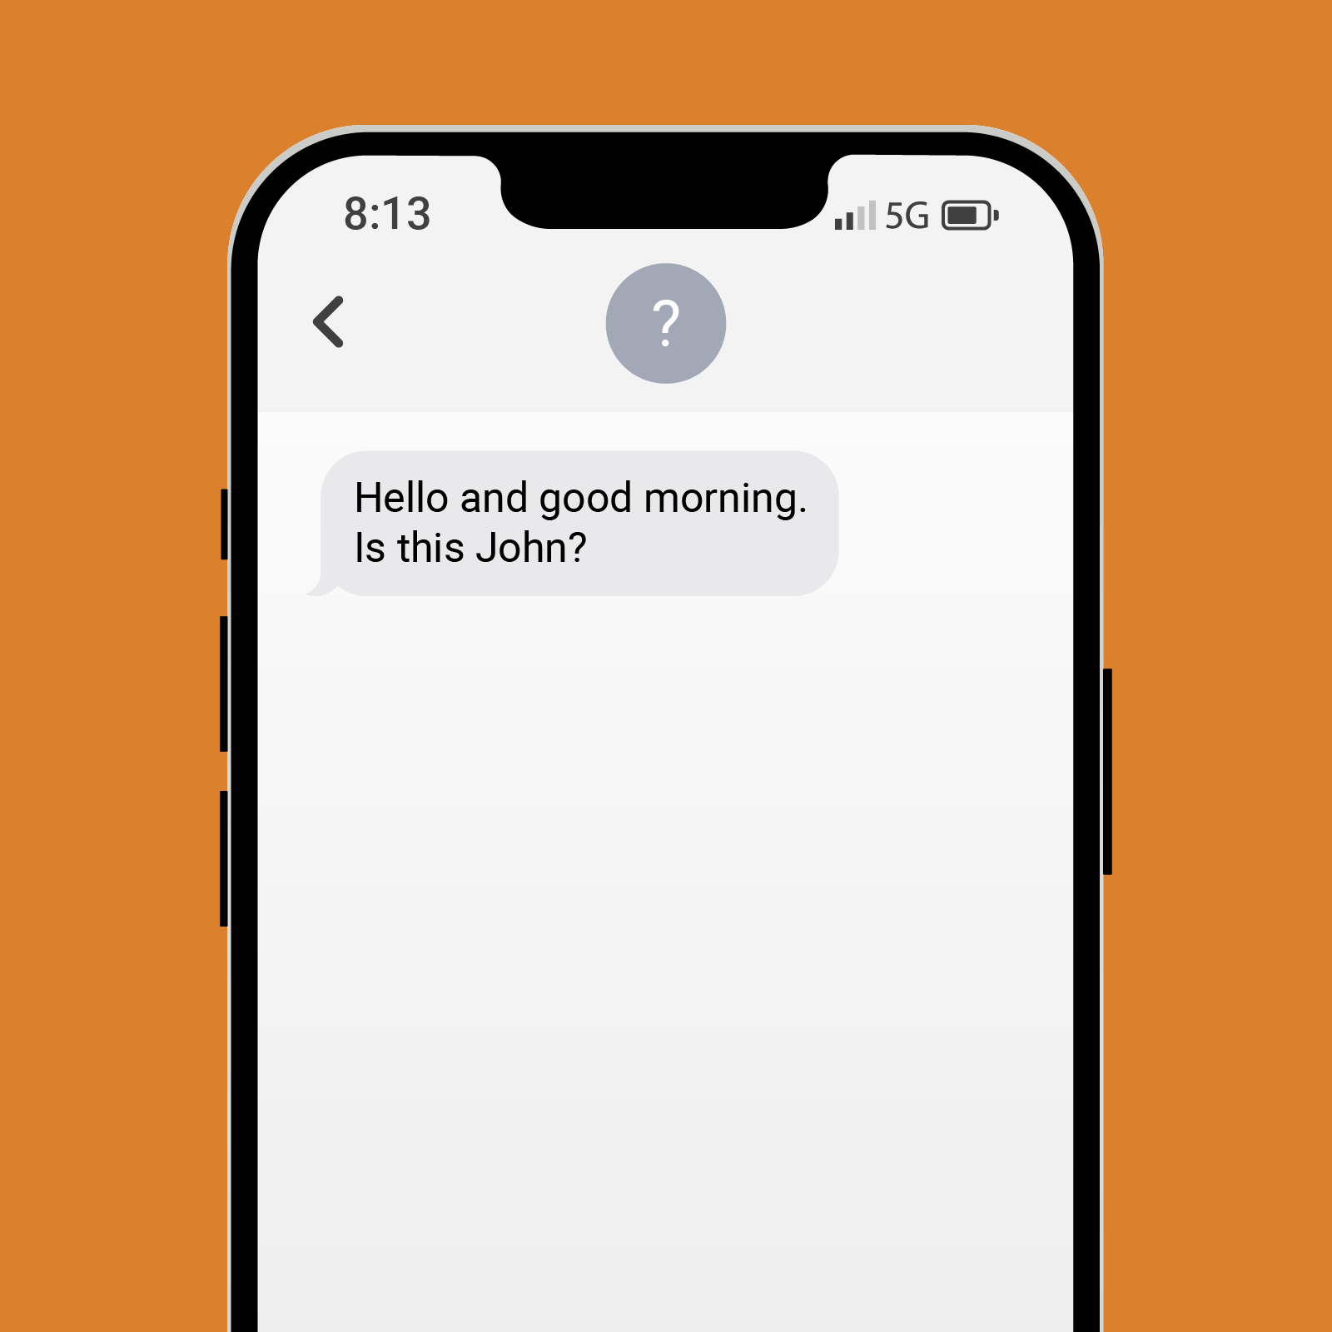

Slide 14
Email Scams (Phishing)
May look official but really fake
Urgent requests for
  Info
  Money
  gift cards
  Verify your account or password
Asks to click on a link or download an attachment

Slide 15
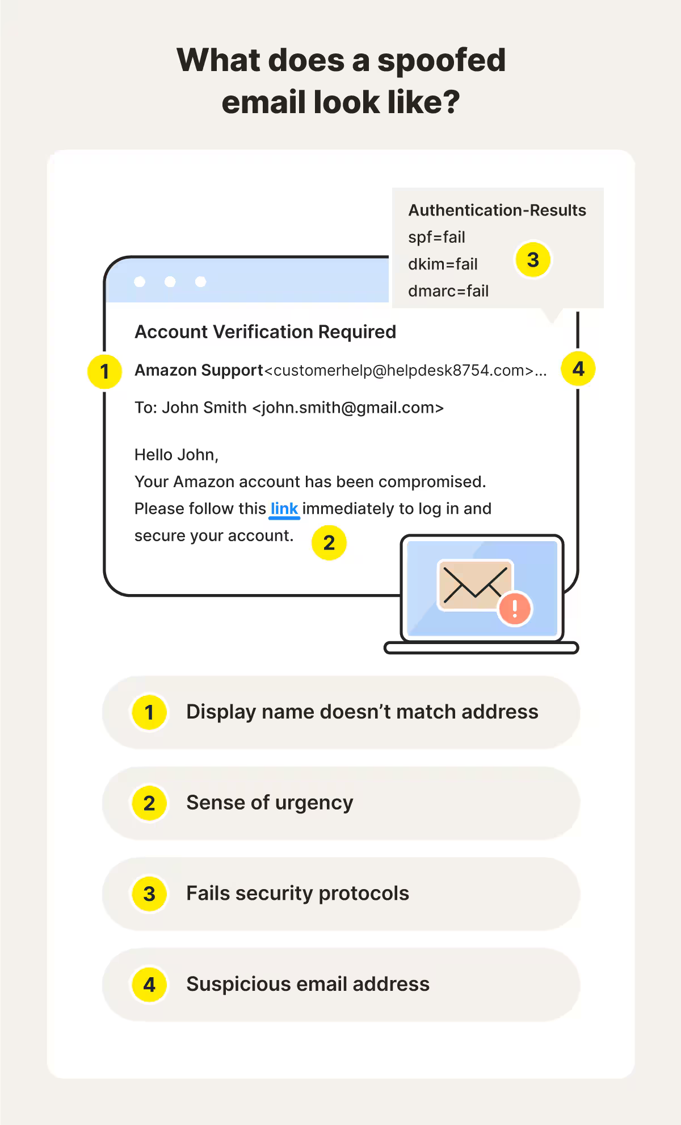

Slide 16
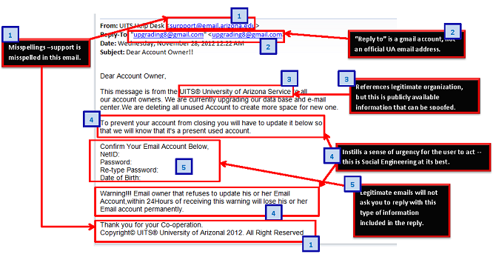

Slide 17
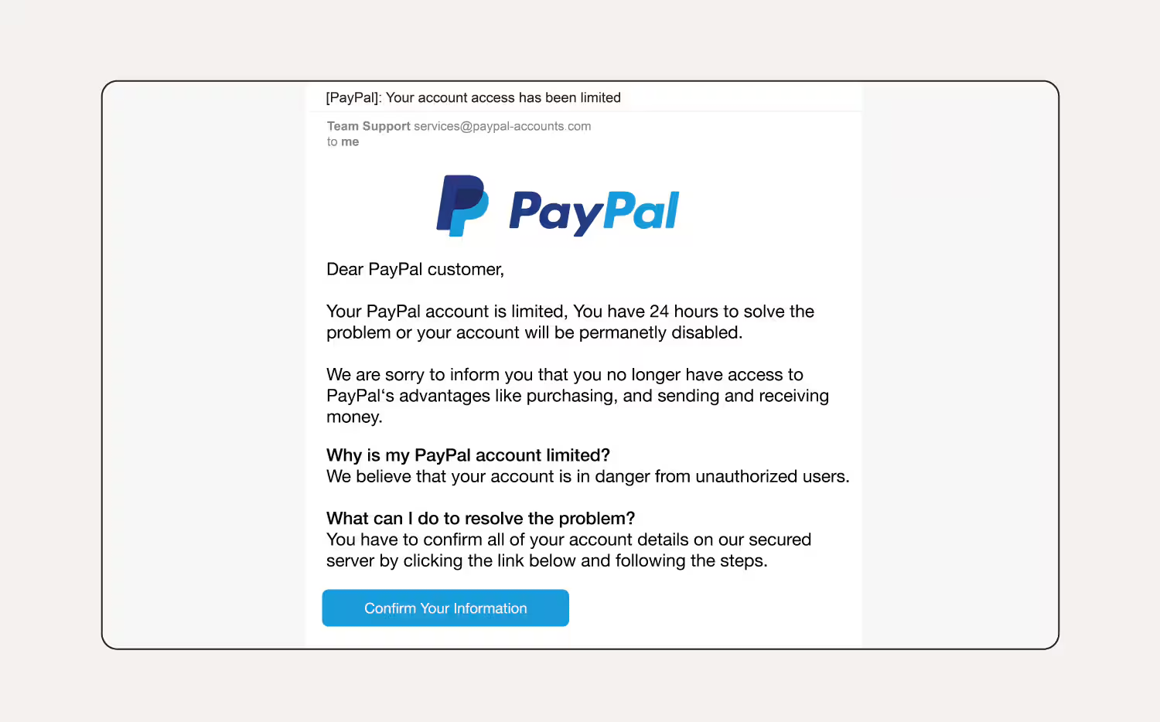

Slide 18
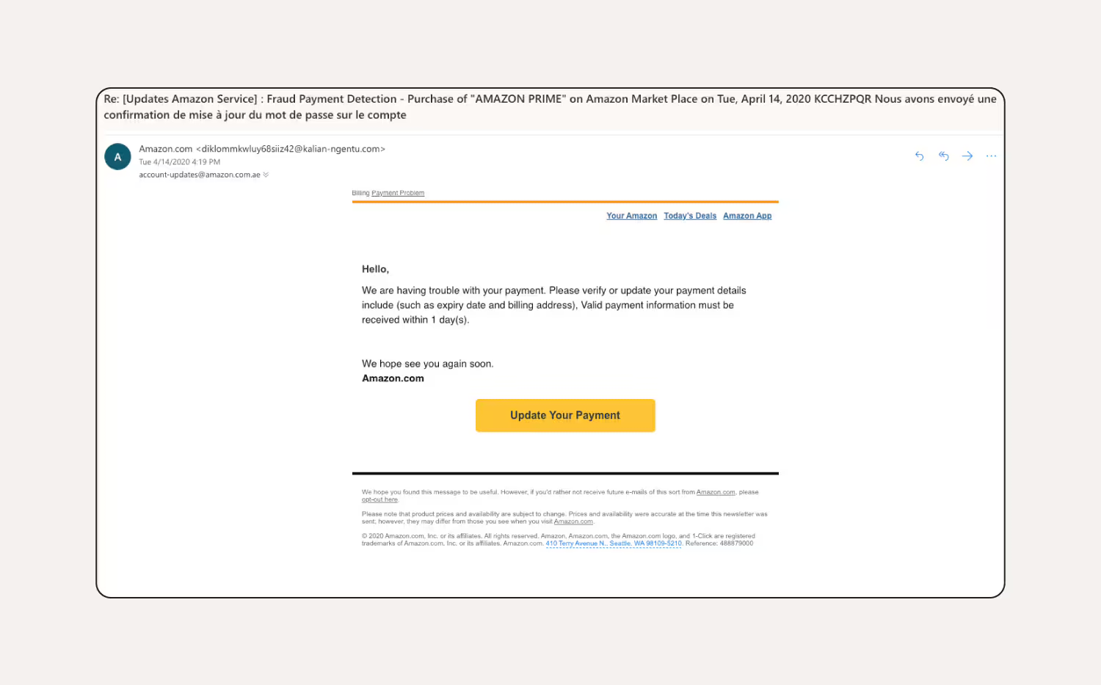

Slide 19
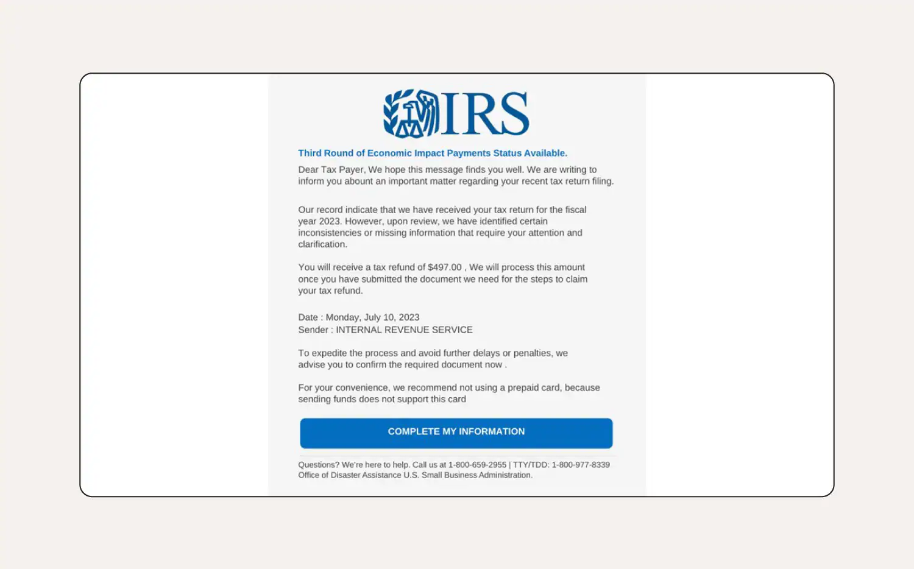

Slide 20
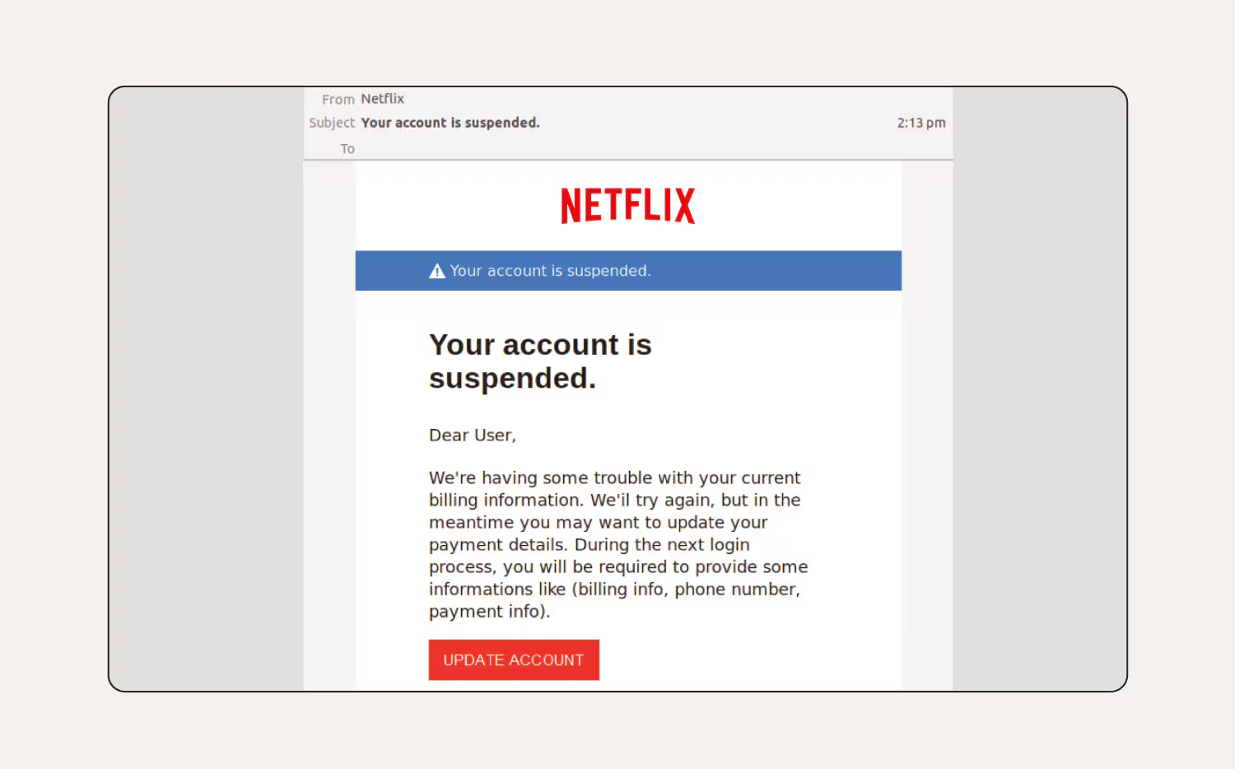

Slide 21
Phone Scams (Vishing)
Fake IRS, tech support, or family emergencies
Spoofed caller IDs
Requests for gift cards, wire transfers, even cash

Slide 22
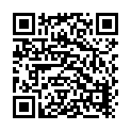
The Day I Put $50,000 in a Shoe Box and Handed It to a Stranger
I never thought I was the kind of person to fall for a scam.
If someone is trying to get you to be compliant, they do it incrementally,
in a series of small steps

Slide 23
Web-Based Scams
Fake shopping sites
Pop-up virus warnings
Impersonated social media accounts
Website spoofing

Slide 24
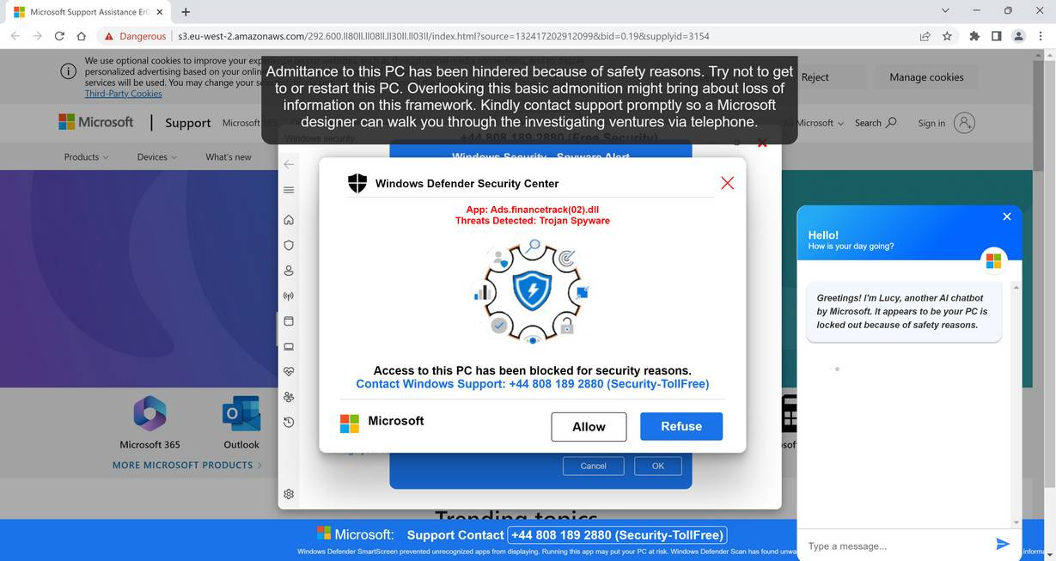

Slide 25
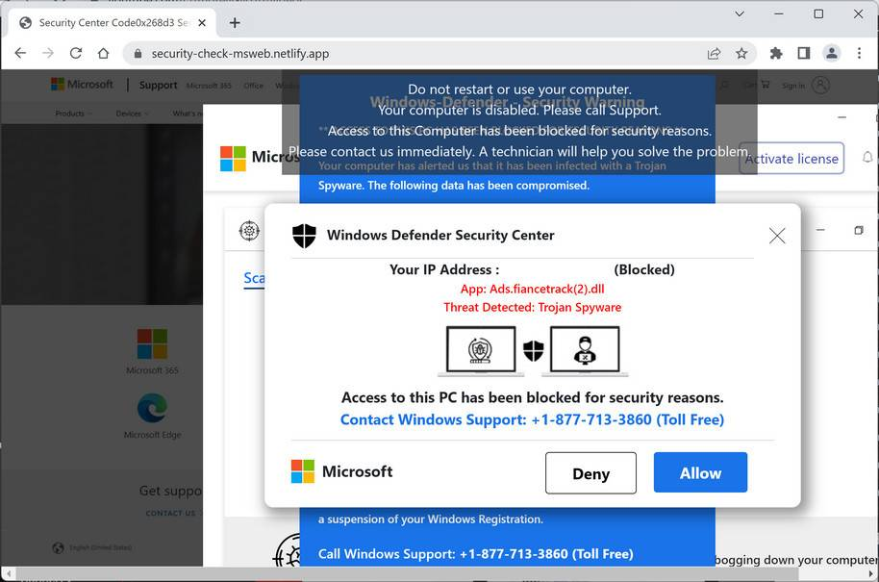

Slide 26
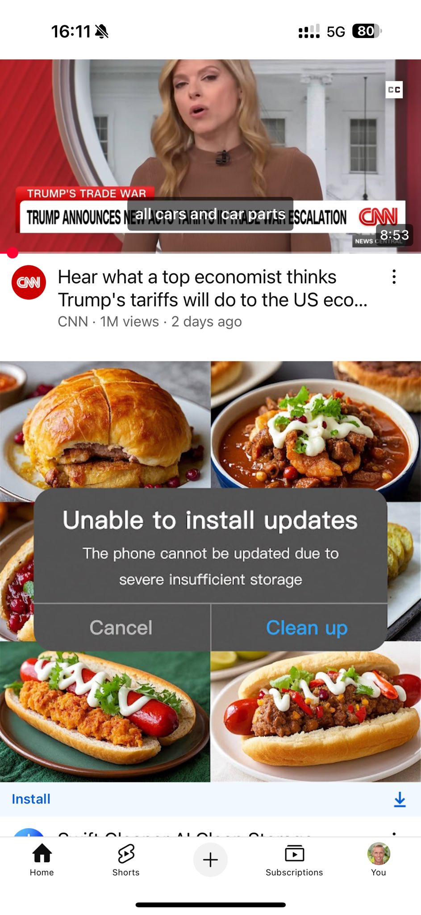

Slide 27
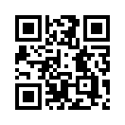
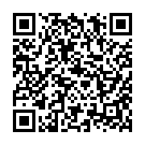
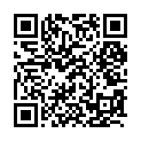
Ad Blockers
AdGuard
Safari on Mac / iPhone / iPad (default browser)
I use the “browser extension” on mac OS and app on iPhone
uBlock Origin Lite
Chrome on Android, PC, or Mac
uBlock Origin
Firefox on PC or Mac

Slide 28
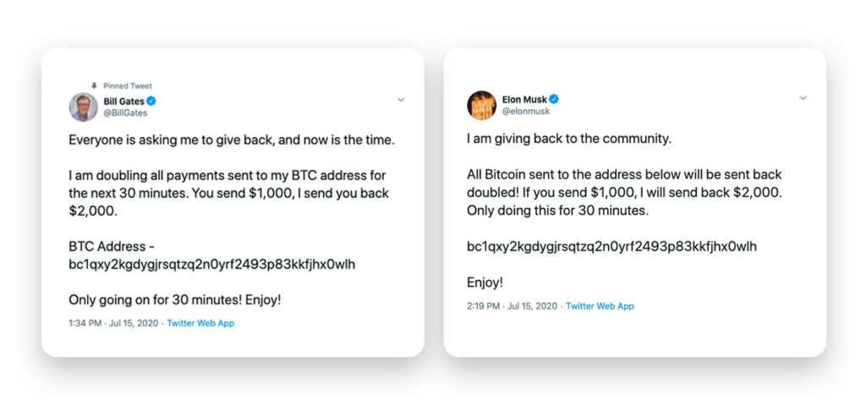

Slide 29
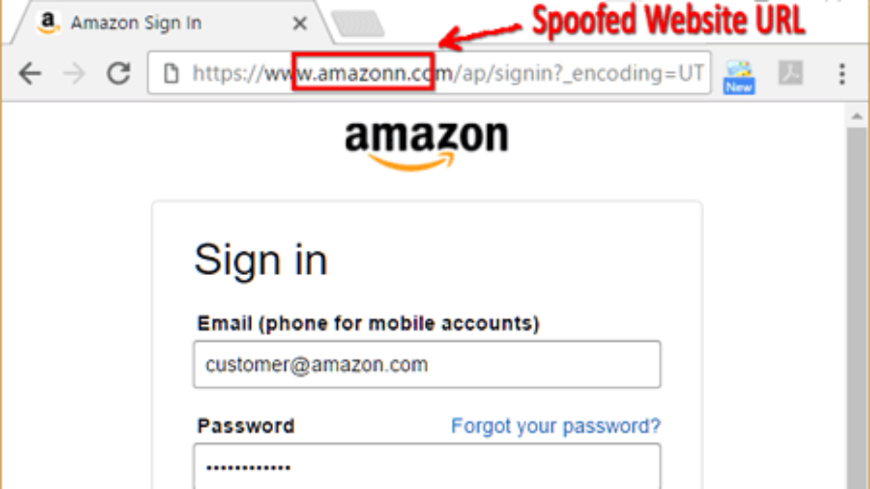

Slide 30
AI-Driven Scams: Emerging Threats
Scams are evolving with artificial intelligence
Deepfakes, voice cloning, and AI-generated messages
Harder to detect, more personalized and convincing

Slide 31
Deepfake Scams
AI-generated video or audio impersonations
Used to fake requests from bosses, celebrities, family
Example: CEO asking for urgent money transfer

Slide 32
Voice Cloning Scams
Uses short audio samples to clone someone's voice
Scammers pretend to be a loved one in distress
Plays off of your emotions to help a love one in need

Slide 33
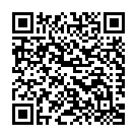
AI Chatbots & Romance Scams (Pig Butchering)
Chatbots build long-term fake relationships
Used for romance scams or fake support chats
Hard to detect due to emotional manipulation

Slide 34
Fake Content & Social Engineering
Fake photos, websites, reviews, and credentials
AI can tailor scams based on social media info
Used for phishing, job scams, and fake investments

Slide 35
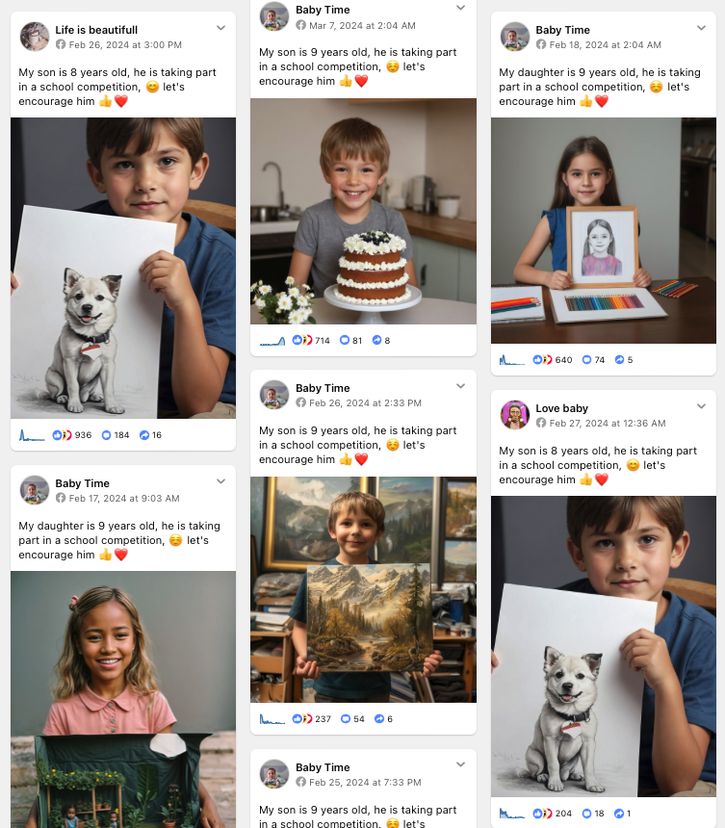

Slide 36


Slide 37
Protecting Against AI Scams
Slow down and take a breath
Verify the request with another method
Use family code words
Limit personal info online

Slide 38
General Protection Tips
Don't click unknown links
Verify contacts independently
Use 2 factor authentication (2FA) and
strong, unique passwords
Keep software up-to-date

Slide 39
Password vs. Passphrase
Password: Short (8–16 chars), complex, harder to remember
  Example: T!m3Tr@v3l!
Passphrase: Long (20+ chars), multiple words, easier to remember
  Example: Sunsets Dance Over Quiet Hills
Security: Passphrases are stronger and harder to crack
Be cautious to whom you share your password to and how!

Slide 40
2FA Methods: Security & Use Cases
🔓 Basic Security – Most Commonly Used
Email: Code sent to inbox; often used for account recovery or low-risk services
SMS: Code via text; common for banking & websites, but vulnerable to SIM swaps or message fatigue or social engineering
🔐 Enhanced Security – Separate Application Needed
Authenticator Apps (e.g., Google Authenticator): Time-based codes; widely used for personal accounts, cloud services
OTP (One-Time Passwords): One-time codes via apps or systems; used in enterprise environments, secure logins
App Verification: Companion app (like for banking) that is used to verify access or transactions
🔒 High Security – Sensitive & Enterprise Use
Hardware Tokens (e.g., YubiKey): Physical device; used for corporate systems, developers, admins, and high-risk accounts. Starting to see these on some online bank accounts

Slide 41
If You’ve Been Scammed
Stop communication immediately
Report to FTC, police, bank, gift card issuer
Change passwords and monitor accounts
Consider a credit freeze
Consider an identify monitoring service

Slide 42
Helpful Resources
https://www.identitytheft.gov
https://www.usa.gov/credit-reports
https://www.annualcreditreport.com/ (only official site to get free credit report)
https://consumer.ftc.gov/articles/what-do-if-you-were-scammed
https://www.pa.gov/agencies/psp/programs/pa-cybercom/cybercrime-reporting-resources-pa-residents.html
https://www.bbb.org
https://decentsecurity.com/#/malware-web-and-phishing-investigation/
Local police non-emergency number

Slide 43
Questions? Final Tips
Stay skeptical, stay safe
Share what you learn
When in doubt — don’t click!

